Slide 1




#RintisKarirImpian
Portofolio - Intensive Bootcamp
SQL For Data Analysis 2
Owner: Muhammad Ridho Muhajir

Slide 2

SQL for Data Analysis 2
Kota dengan revenue tertinggi
Query:
WITH top_city AS (
SELECT city, SUM(sales) AS total_revenue
FROM `tokopaedi.orders`
GROUP BY city
ORDER BY total_revenue DESC
LIMIT 1
)
SELECT o.city, SUM(o.sales) AS total_revenue
FROM `tokopaedi.orders` AS o
JOIN top_city tc ON o.city = tc.city
GROUP BY o.city
ORDER BY total_revenue DESC
#RintisKarirImpian

Slide 3
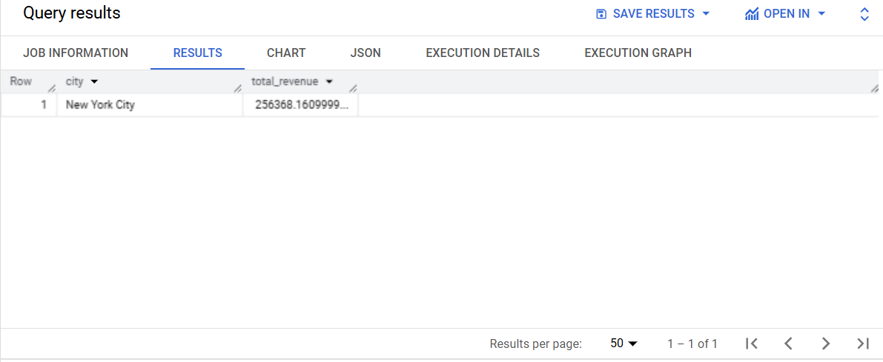
SQL for Data Analysis 2
Kota dengan revenue tertinggi
#RintisKarirImpian

Slide 4
SQL for Data Analysis 2
Rata-rata spending per konsumen pada kota dengan revenue tertinggi
Query:
WITH top_city AS (
SELECT city, SUM(sales) AS total_revenue
FROM `tokopaedi.orders`
GROUP BY city
ORDER BY total_revenue DESC
LIMIT 1
),
avg_spending AS (
SELECT o.city, AVG(o.sales) AS avg_spending
FROM `tokopaedi.orders` AS o
JOIN top_city AS tc ON o.city = tc.city
GROUP BY o.city
)
SELECT o.customer_name, o.city, SUM(o.sales) AS total_spending, a.avg_spending
FROM `tokopaedi.orders` AS o
JOIN top_city AS tc ON o.city = tc.city
JOIN avg_spending AS a ON o.city = a.city
GROUP BY o.customer_name, o.city, a.avg_spending
ORDER BY total_spending DESC
#RintisKarirImpian

Slide 5
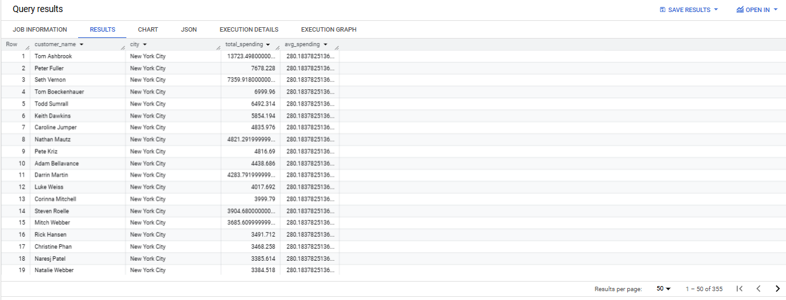
SQL for Data Analysis 2
Rata-rata spending per konsumen pada kota dengan revenue tertinggi
#RintisKarirImpian

Slide 6
SQL for Data Analysis 2
Nama-nama konsumen dengan spending di atas rata-rata di kota dengan revenue tertinggi
Query:
WITH top_city AS (
SELECT city, SUM(sales) AS total_revenue
FROM `tokopaedi.orders`
GROUP BY city
ORDER BY total_revenue DESC
LIMIT 1
),
avg_spending AS (
SELECT o.city, AVG(o.sales) AS avg_spending
FROM `tokopaedi.orders` AS o
JOIN top_city tc ON o.city = tc.city
GROUP BY o.city
)
SELECT o.customer_name, o.city, SUM(o.sales) AS total_spending, a.avg_spending
FROM `tokopaedi.orders` AS o
JOIN top_city tc ON o.city = tc.city
JOIN avg_spending a ON o.city = a.city
GROUP BY o.customer_name, o.city, a.avg_spending
HAVING SUM(o.sales) > a.avg_spending
ORDER BY total_spending DESC
#RintisKarirImpian

Slide 7
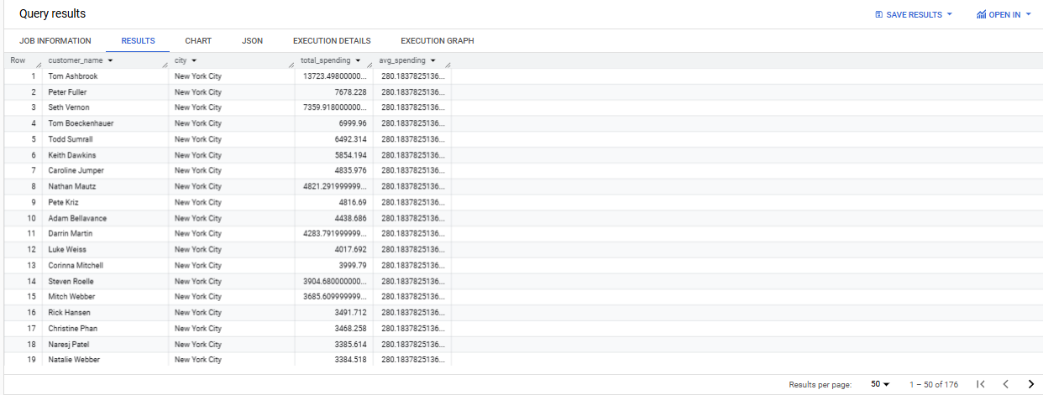
SQL for Data Analysis 2
Nama-nama konsumen dengan spending di atas rata-rata di kota dengan revenue tertinggi
#RintisKarirImpian

Slide 8
Terima Kasih
Build your skill and portfolio via myskill.id/bootcamp
#RintisKarirImpian

